Slide 1
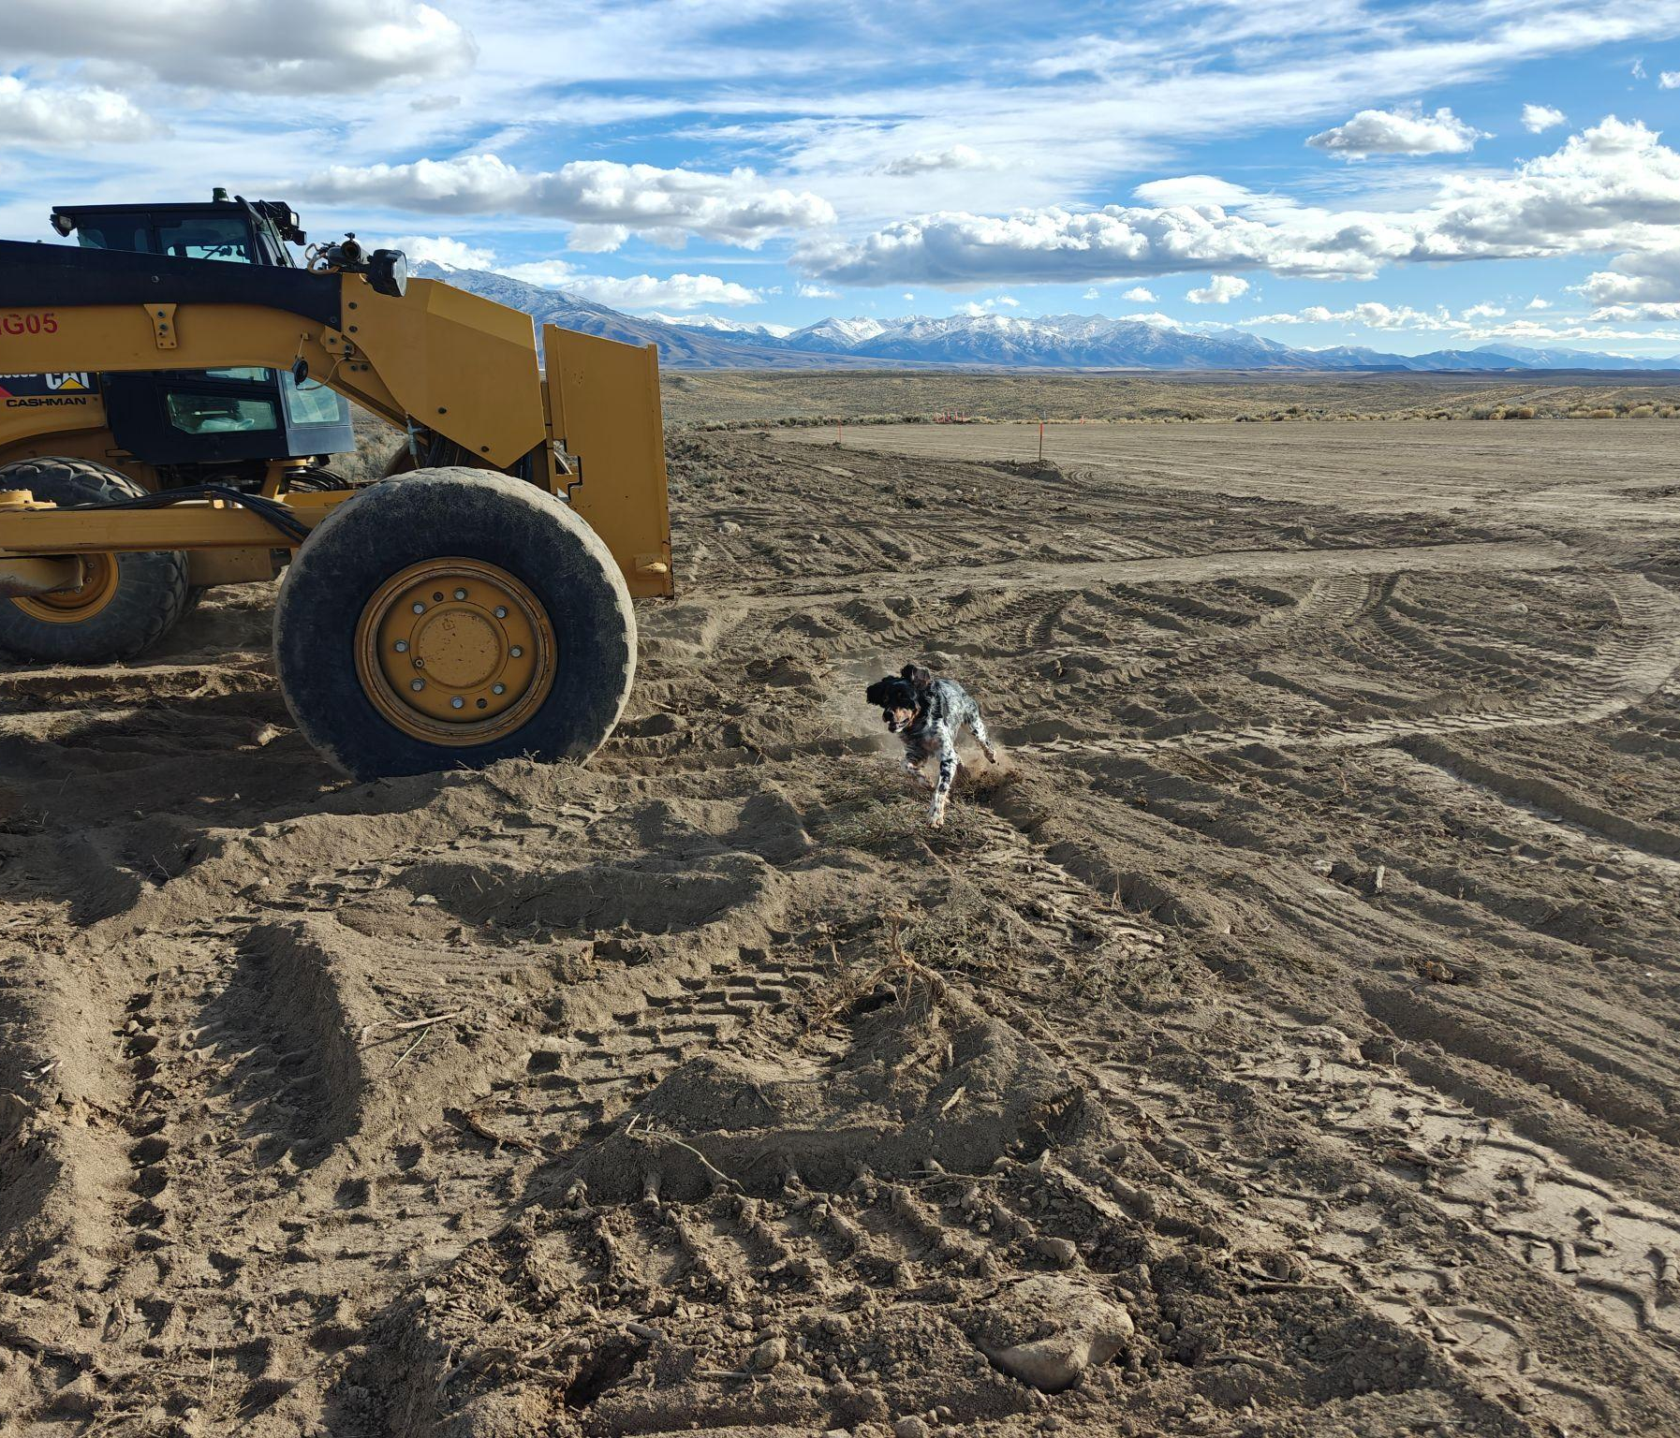
Lamoille Summit Trail System
Hilltop Trailhead
Elko Trail System Initiative
Month Year

Slide 2
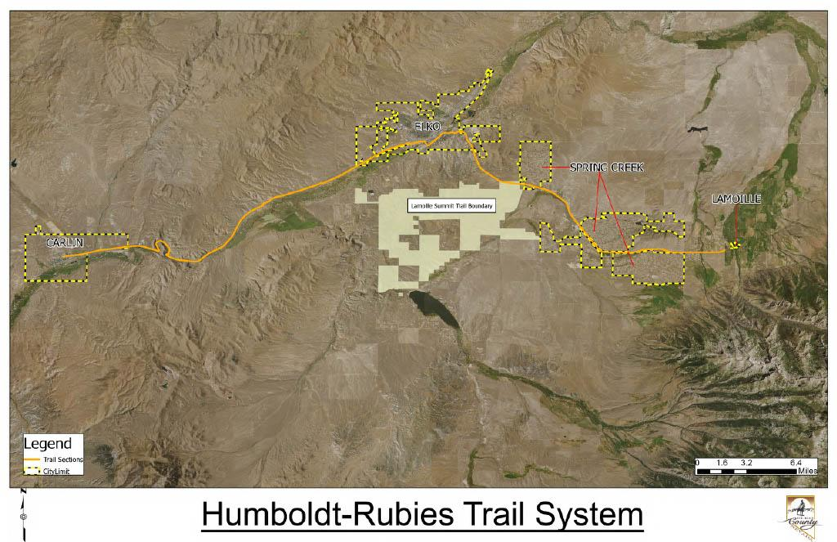
ETSI

Slide 3
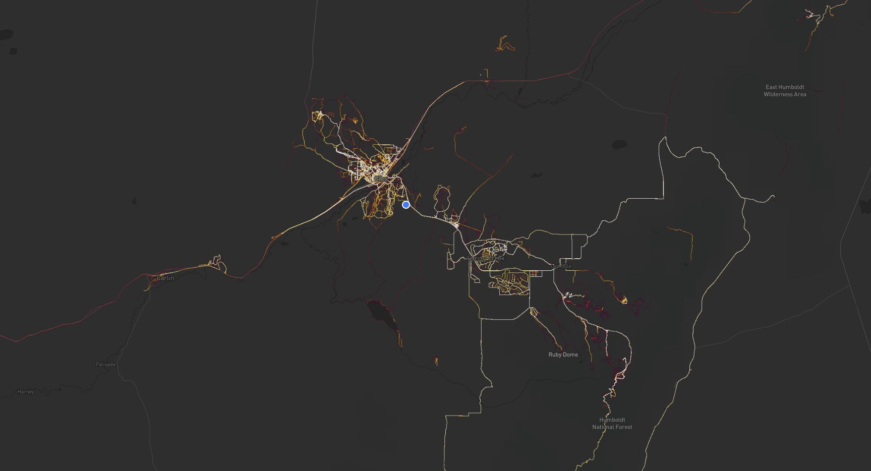
Heat Map
Elko Trail System Initiative

Slide 4
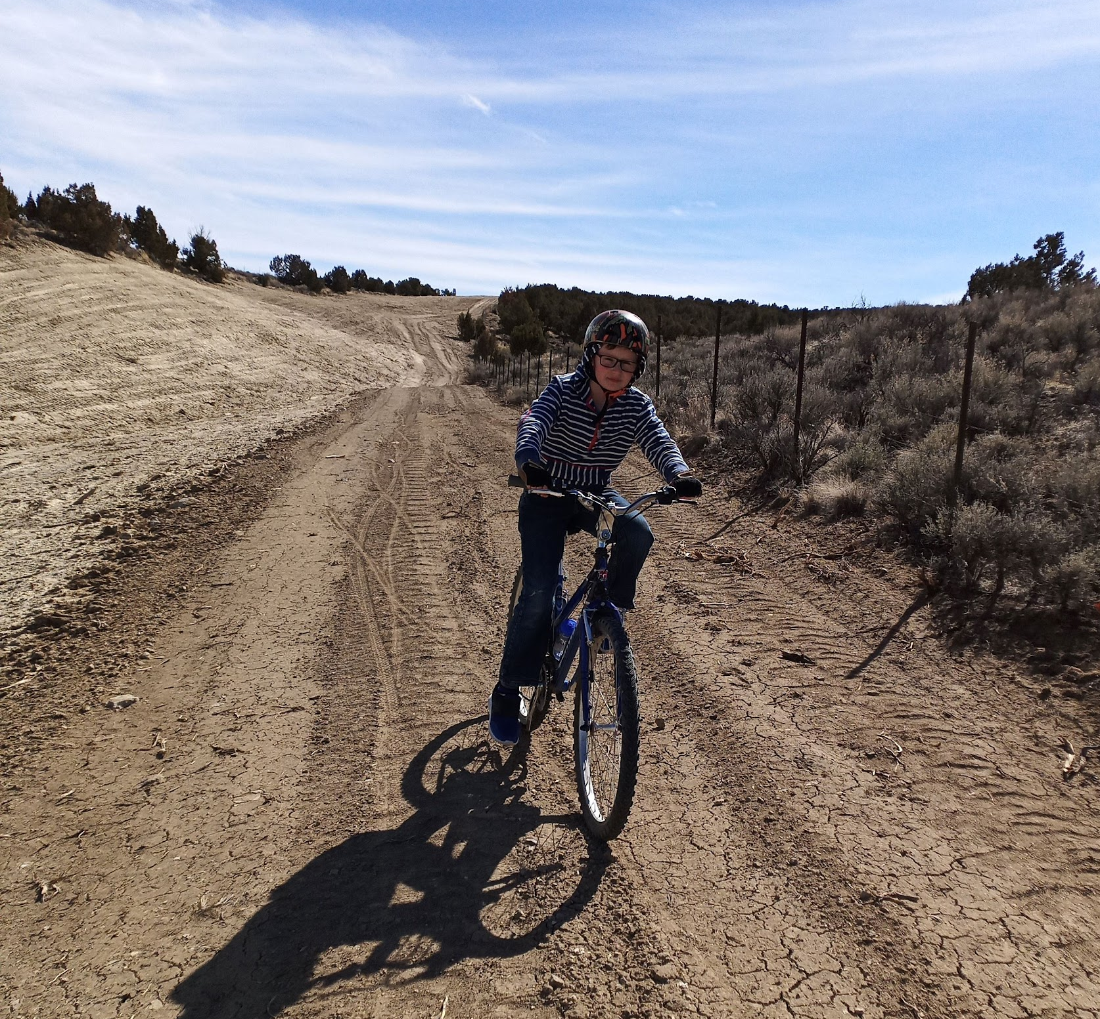
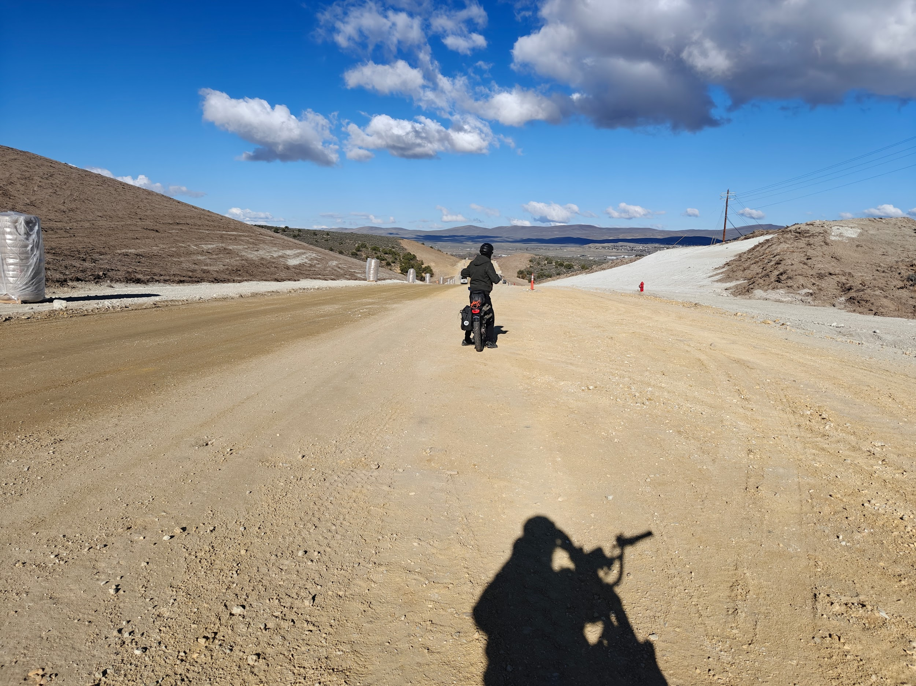
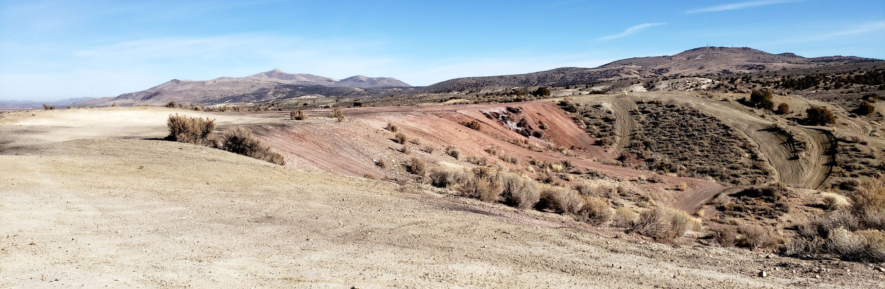
Drivers
Elko Trail System Initiative

Slide 5
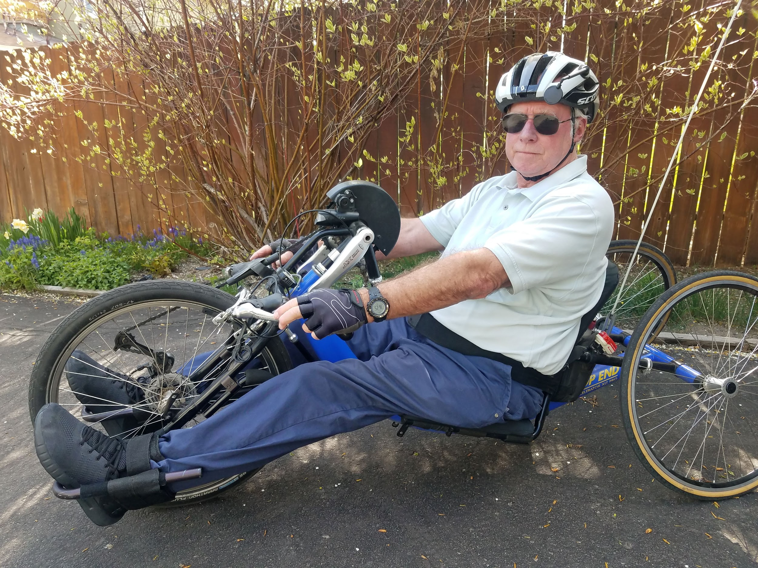
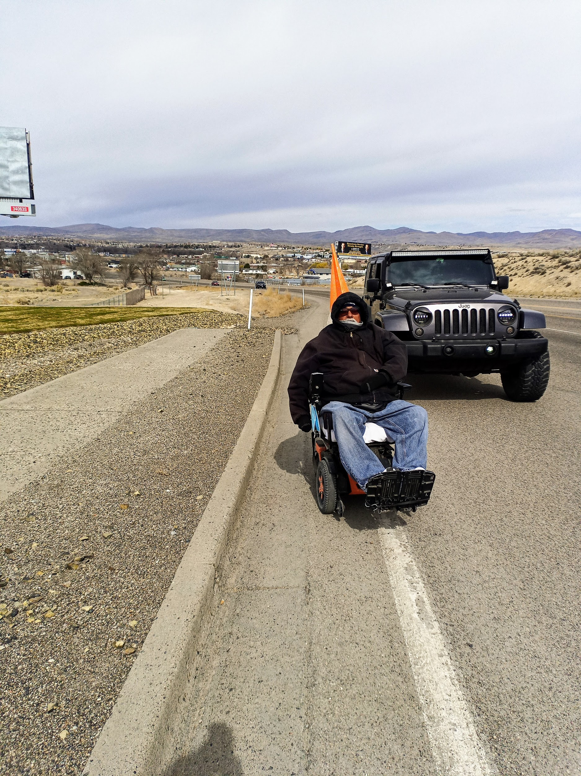
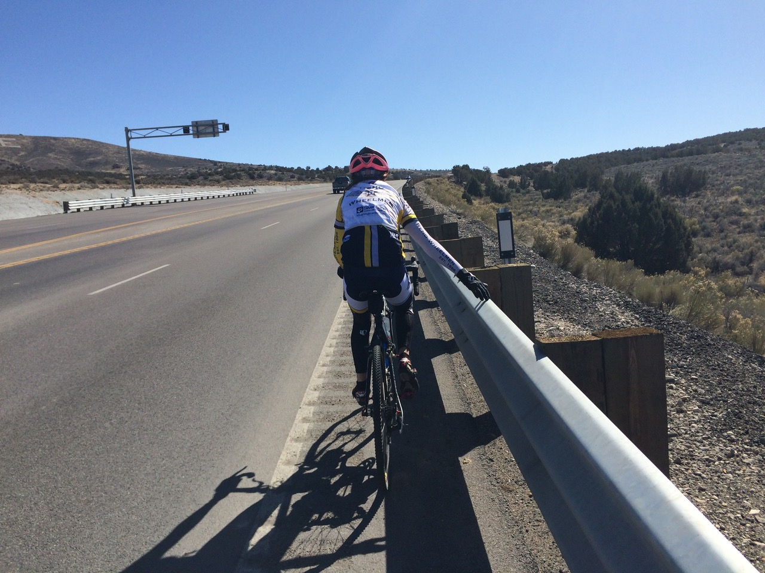
Break down access barriers
Elko Trail System Initiative

Slide 6
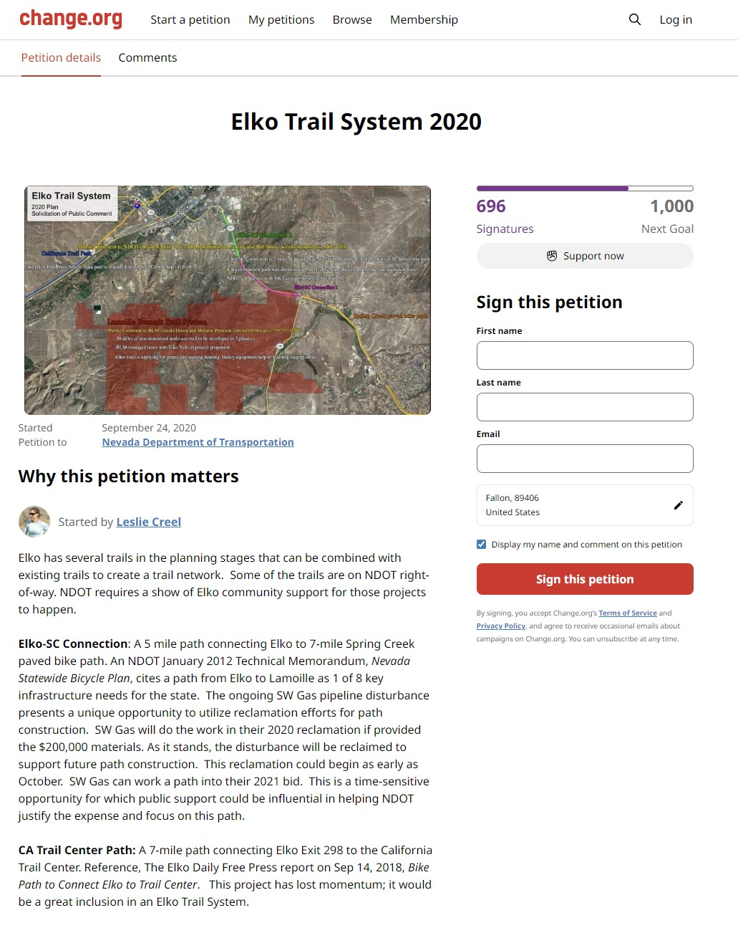
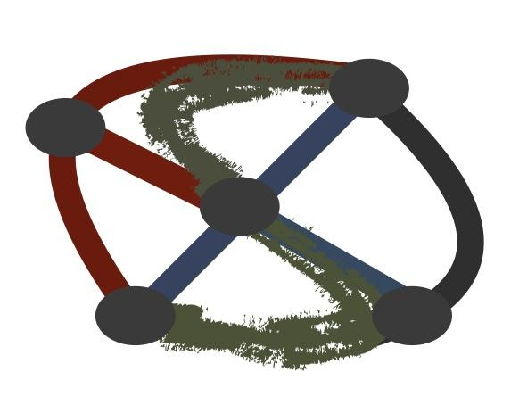
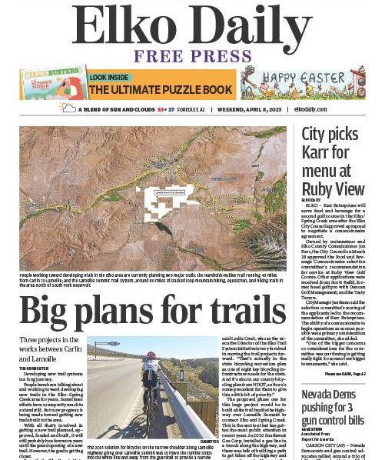

Building the Community
Sept 2020
Dec 2021
April 2023
Elko Trail System Initiative

Slide 7
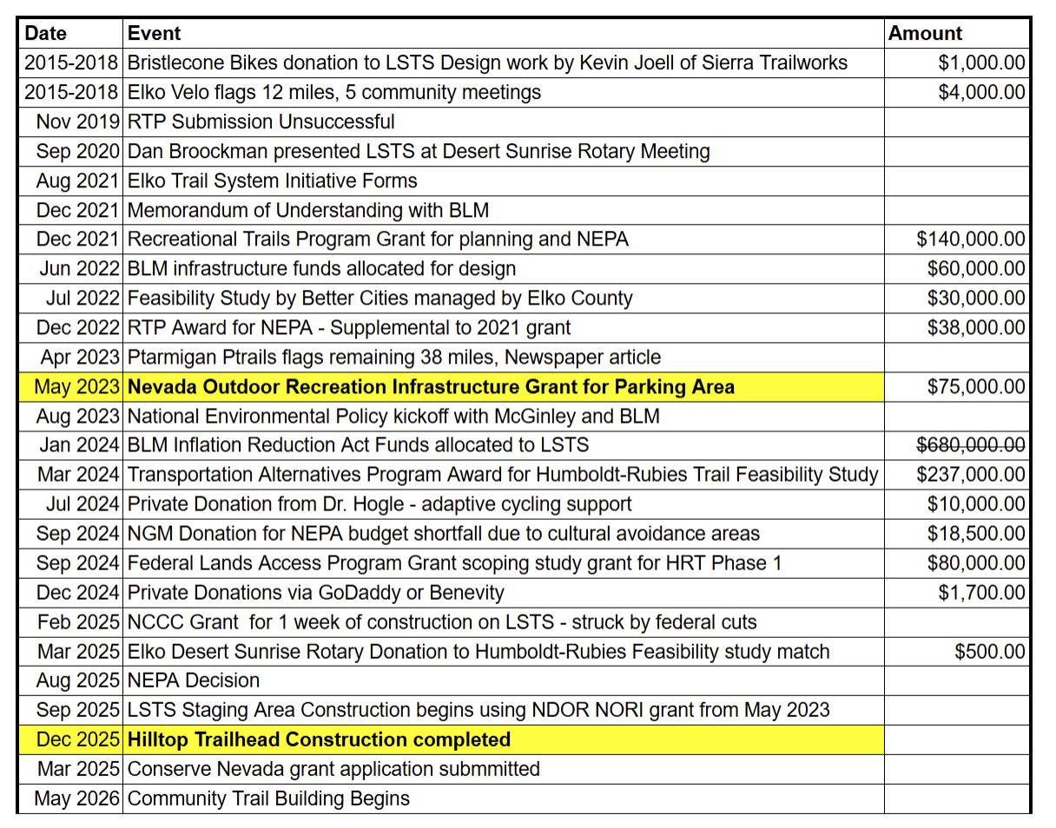
Moving at the pace of community capacity and alignment
2.5 years
Elko Trail System Initiative

Slide 8
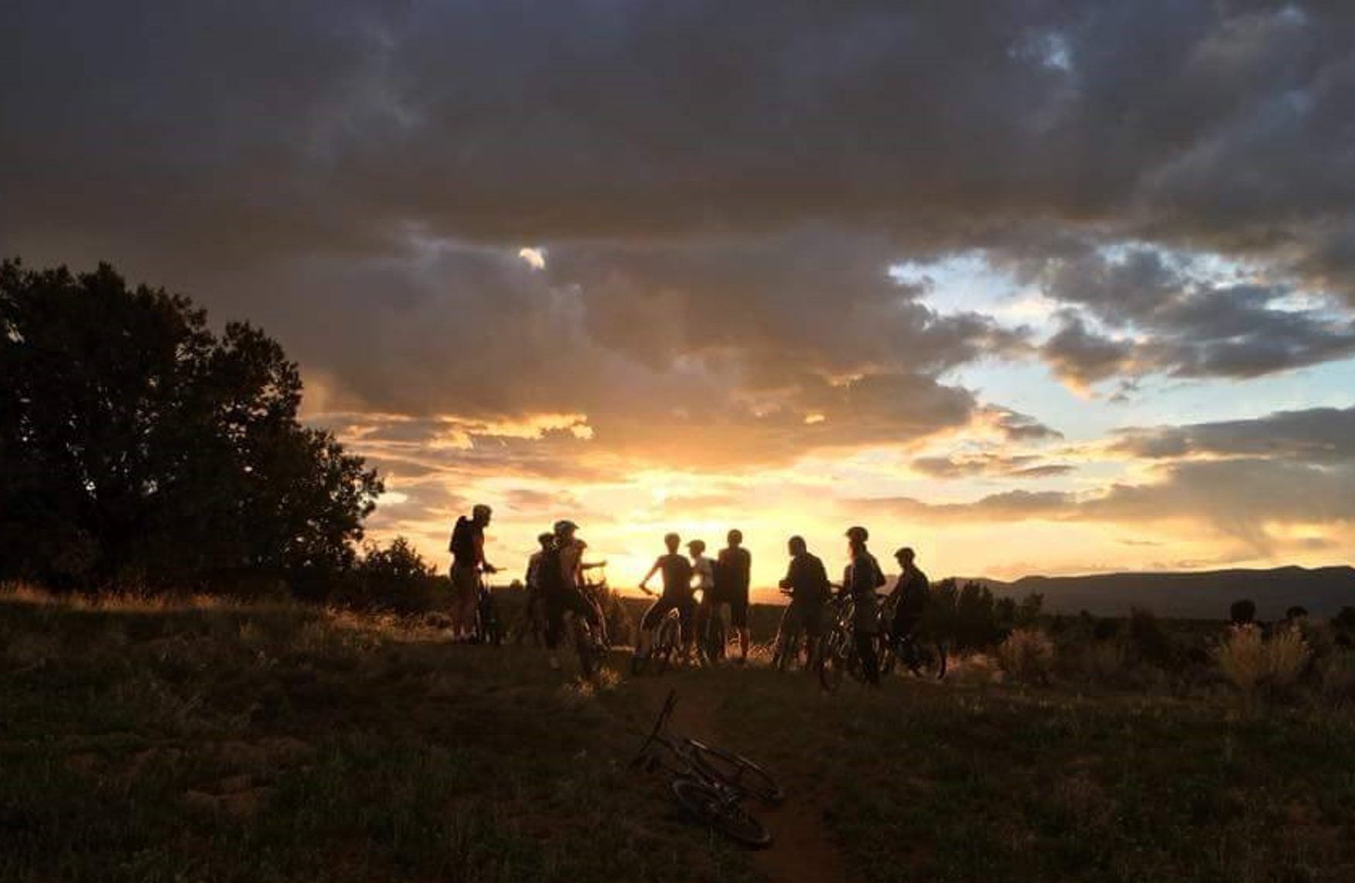
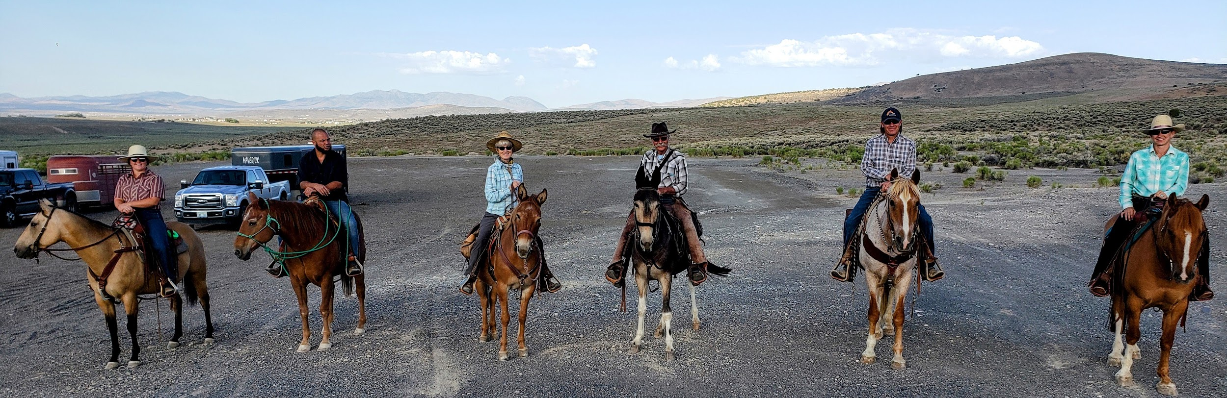
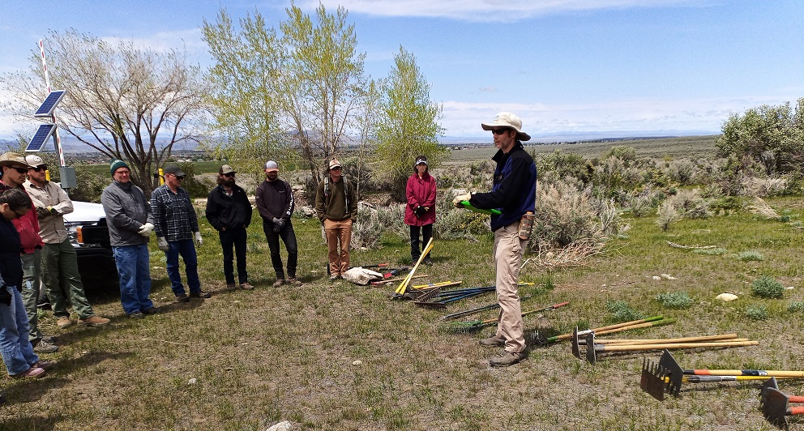
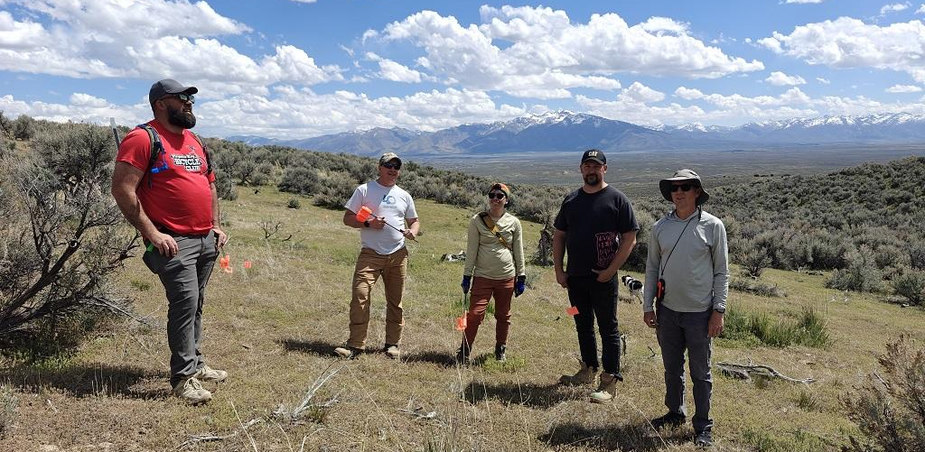
2015
2022
2021
2026
Elko Trail System Initiative

Slide 9
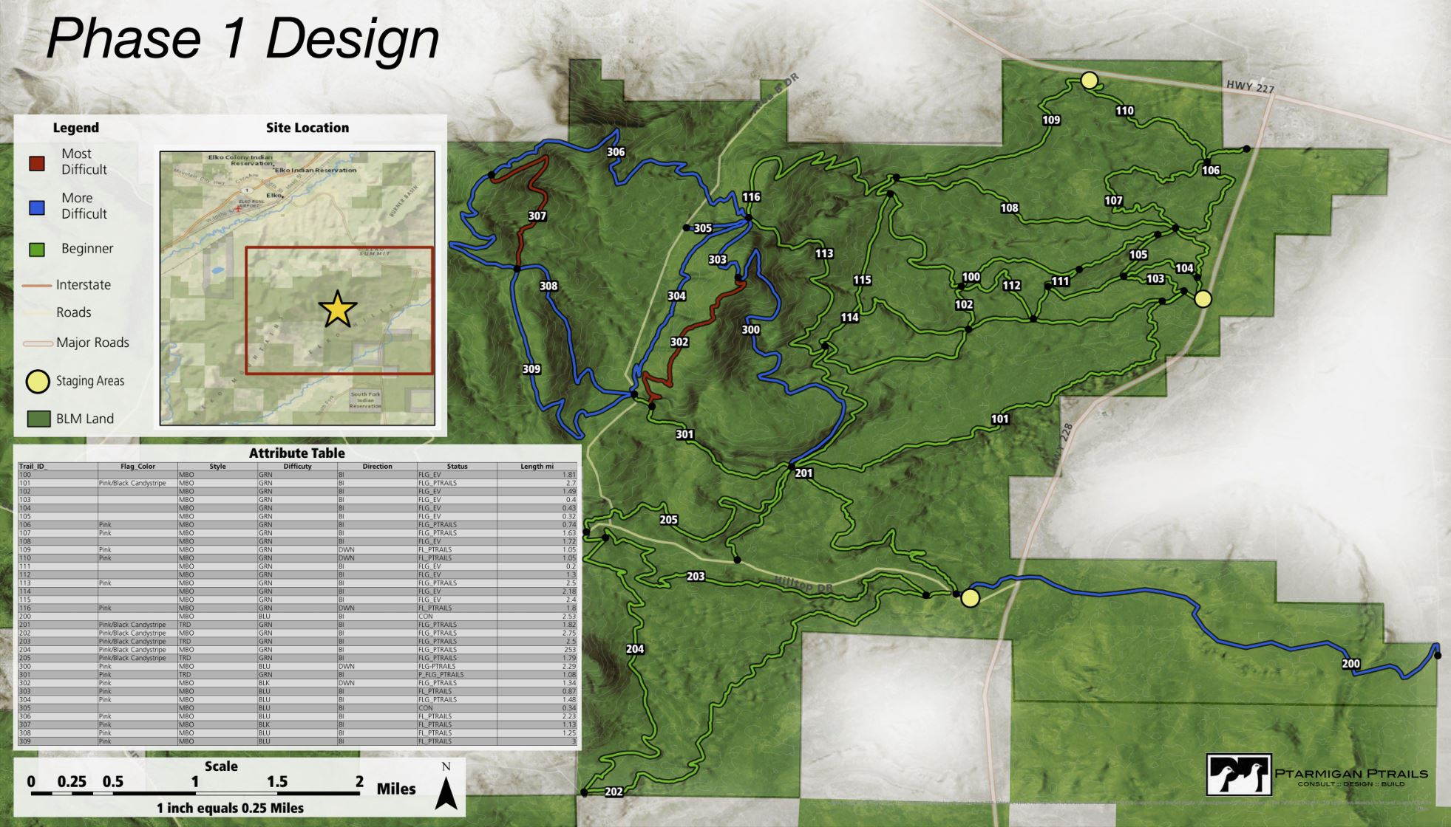
Elko Trail System Initiative

Slide 10

Elko High School Advanced Graphics Design Class Logo Project
Elko Trail System initiative

Slide 11
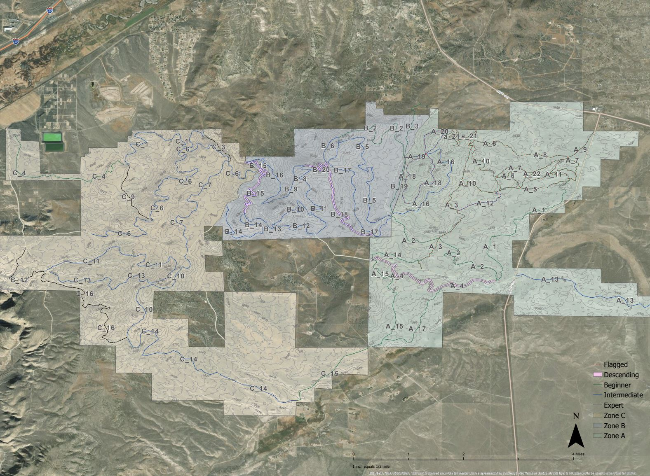
Growth Potential
Elko Trail System Initiative

Slide 12
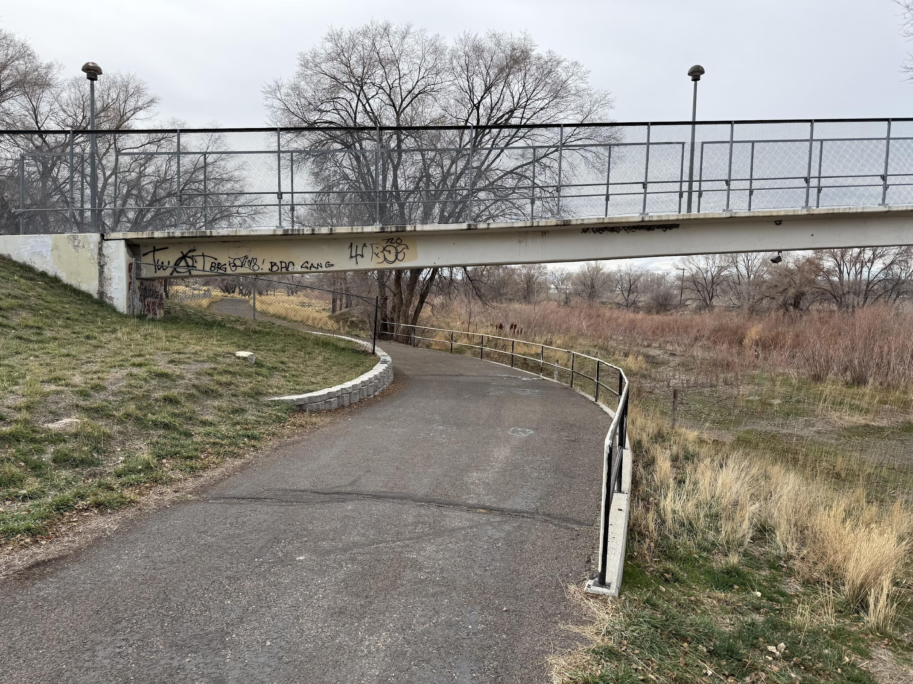
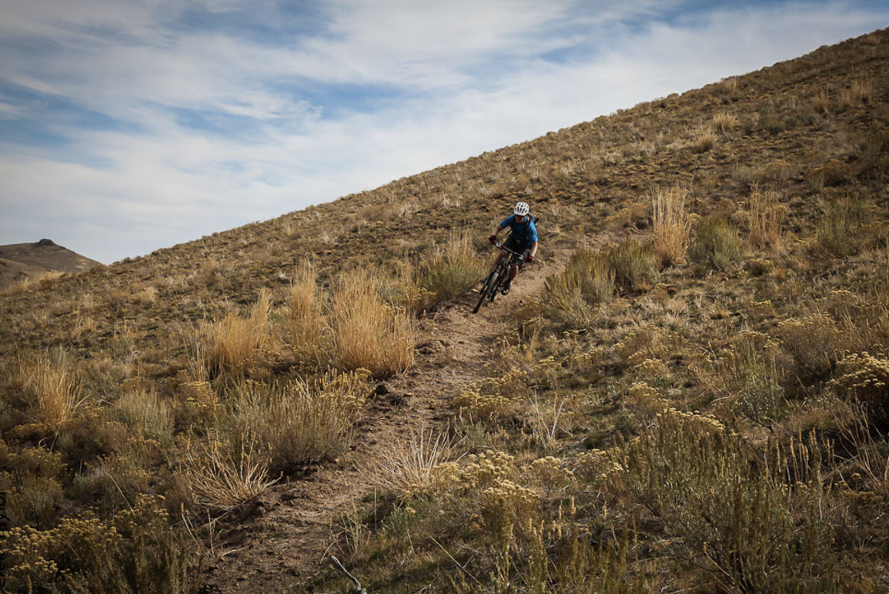
Elko Trail System
Elko Trail System Initiative
Notes:
Umbrella of Elko Trail System, Regional Humboldt-Rubies Trail,

Slide 13
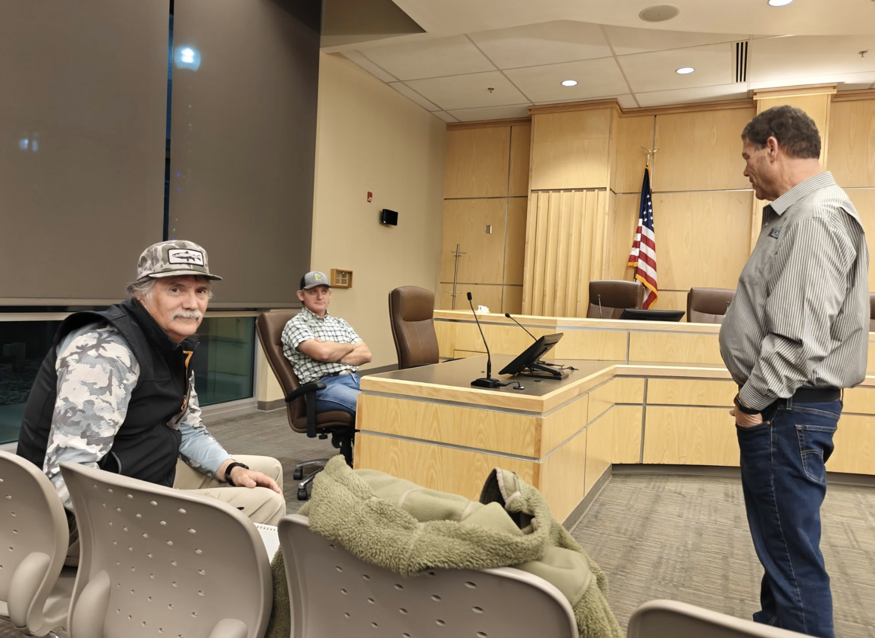
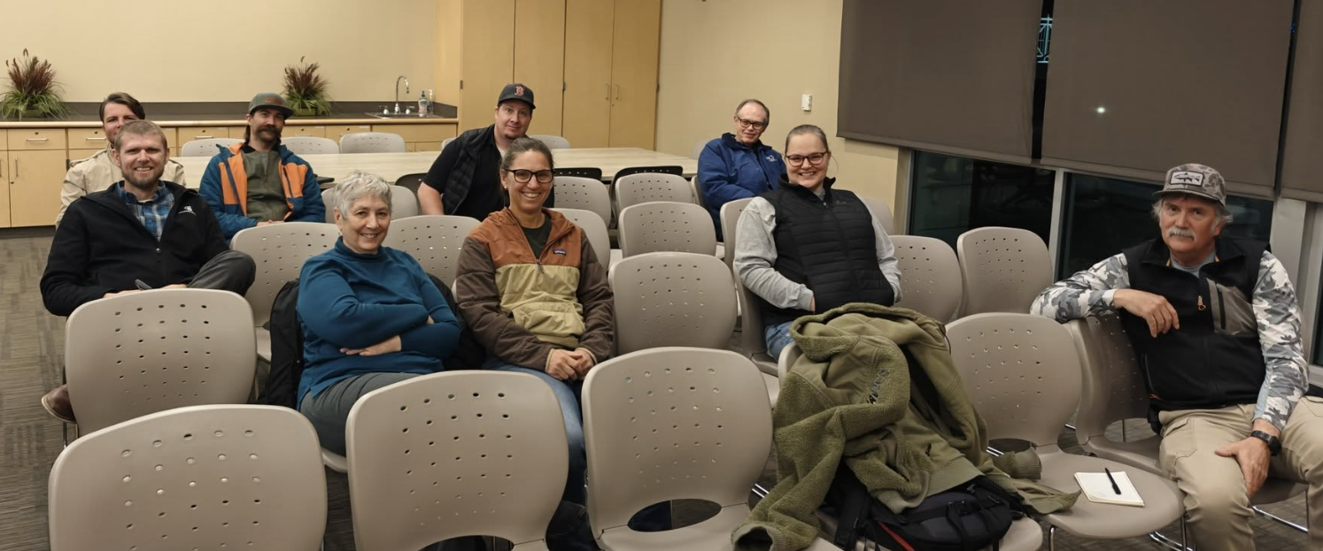
Stakeholder Engagement
Elko Trail System Initiative
Notes:
Finishing up with cost estimates for all 4 phases. Draft report in May. Then review period.

Slide 14
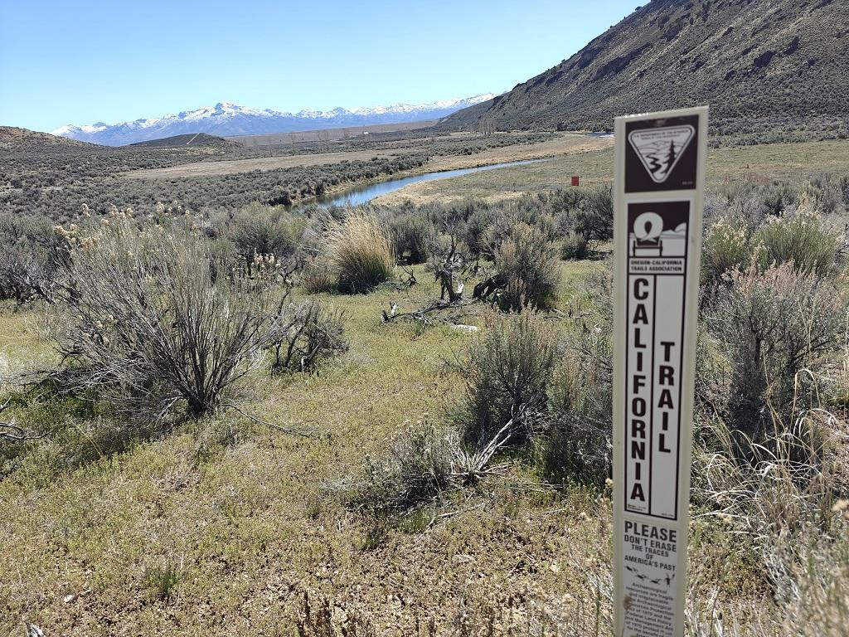
Elko was a place people passed through on a trail.
Elko Trail System Initiative

Slide 15
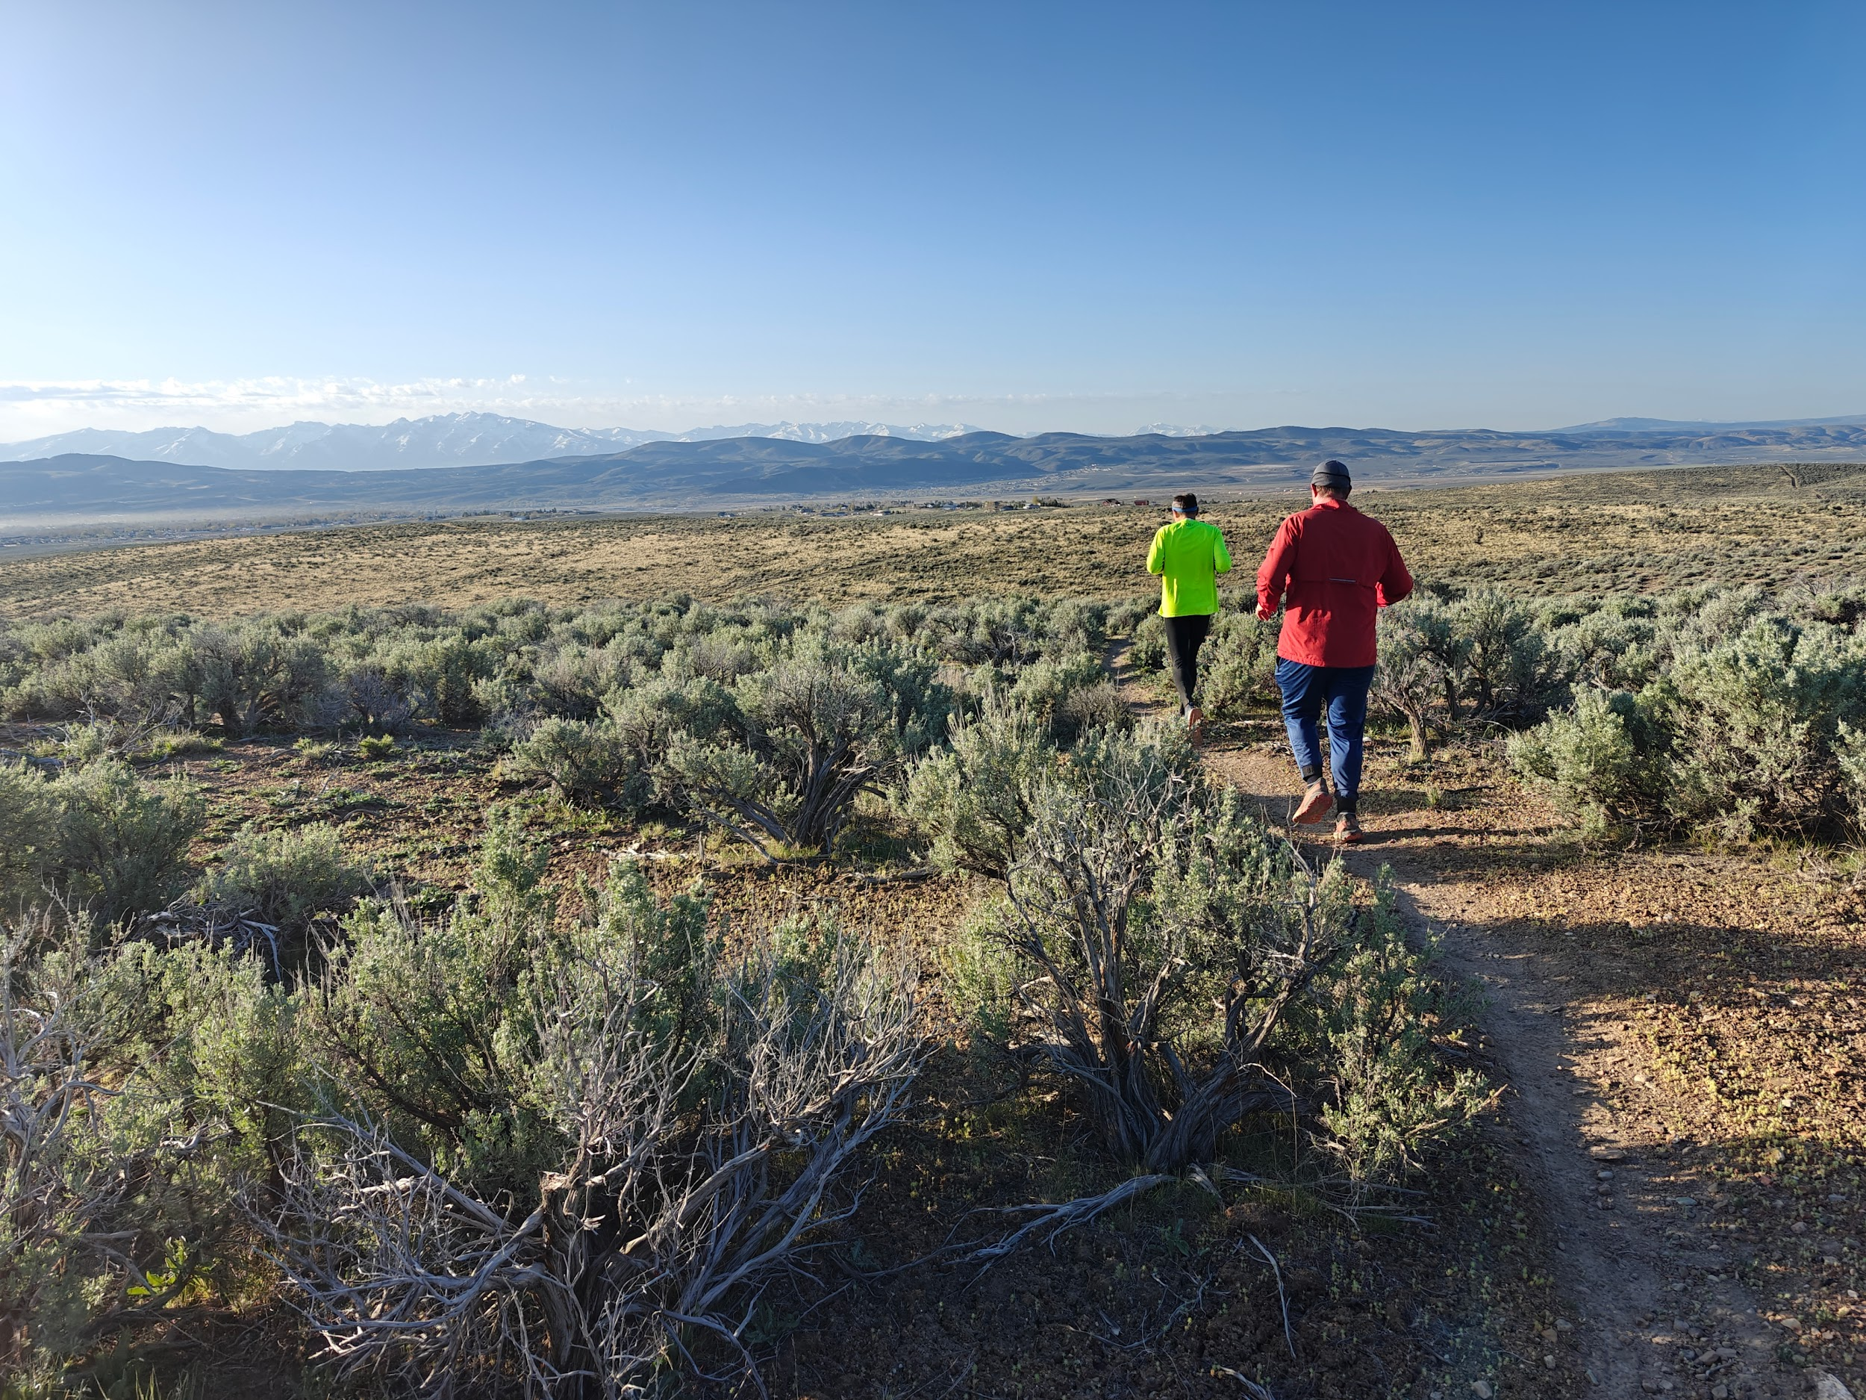
Now we build trails that invite people to stay.
Elko Trail System Initiative

