Slide 1
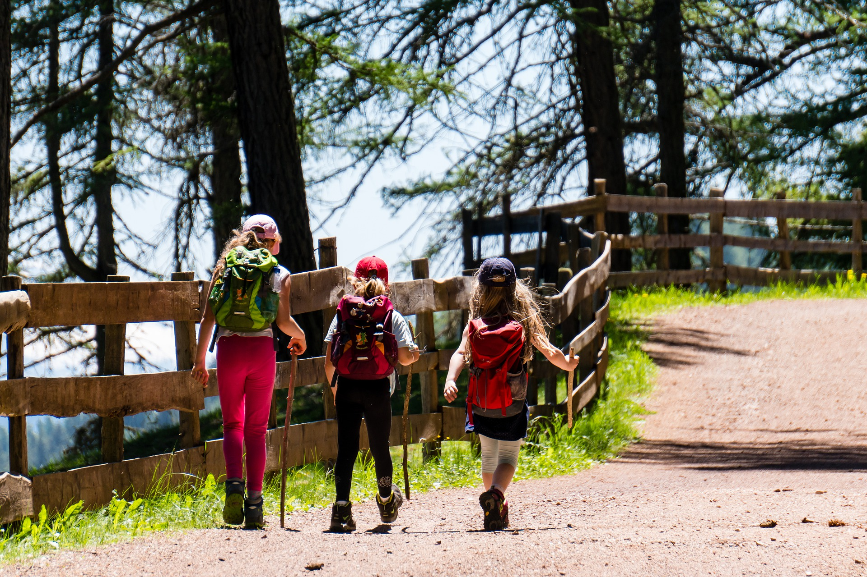



Outdoor Education Advisory Working Group
Outdoor Education Case Studies
________
January 30, 2024
Presented by:
Nevada Division of
Outdoor Recreation
Logo Owned by NDCNR.
ndor.nv.gov
Photos courtesy of Travel Nevada

Slide 2
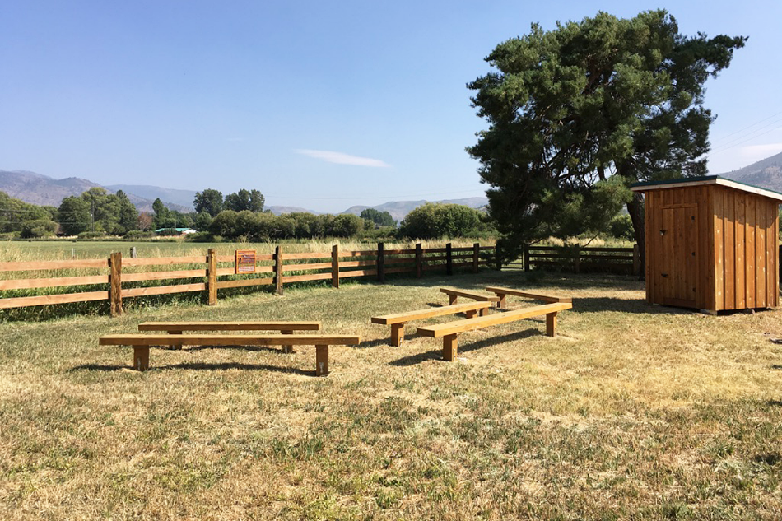
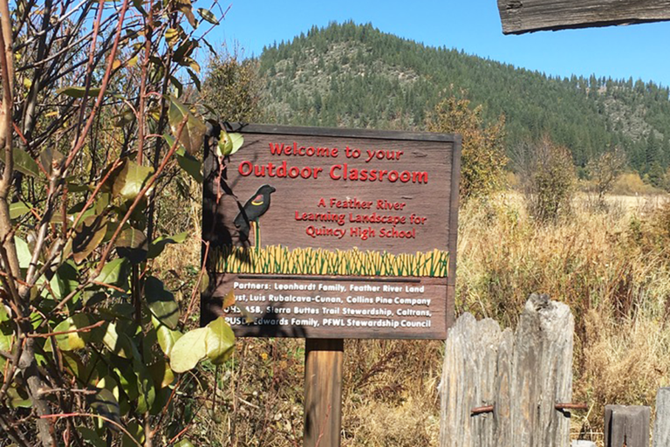
Case Study
- - - - - - - - - - - - - - - - - - - - - - - - - - - - - - - - - - - - - - - - - - - - -
Plumas County School District Outdoor Core
Infrastructure
Living schoolyards
  On-campus outdoor classrooms
Learning Landscapes
  10-minute walk to off-campus field site with trails, stewardship projects, etc.
Photo via Ten Strands
Elisabeth Johnson ​
Program Officer
Notes:
Local land trust helps secure these spaces
MOU to use off-campus sites

Slide 3



Case Study
- - - - - - - - - - - - - - - - - - - - - - - - - - - - - - - - - - - - - - - - - - - - -
Plumas County School District Outdoor Core
Program Design
Yearly science focused themes
Place-based curriculum
Standards integration
Regular instructional time outdoors
Elisabeth Johnson ​
Program Officer
Notes:
Kindergarten does garden, 5th grade does birds, 6th grade does watershed

Slide 4
Case Study
- - - - - - - - - - - - - - - - - - - - - - - - - - - - - - - - - - - - - - - - - - - - -
Plumas County School District Outdoor Core
Partnerships
20+ local partner organizations
Land trust support
Science mentors for teachers
Elisabeth Johnson ​
Program Officer

Slide 5
Case Study
- - - - - - - - - - - - - - - - - - - - - - - - - - - - - - - - - - - - - - - - - - - - -
Plumas County School District Outdoor Core
Personnel
Outdoor Core Program Coordinator
  Consistent vision
  Funding
Teacher training and ongoing support
  Yearly skill building opportunities
  Check-ins with Program Coordinator
Elisabeth Johnson ​
Program Officer

Slide 6
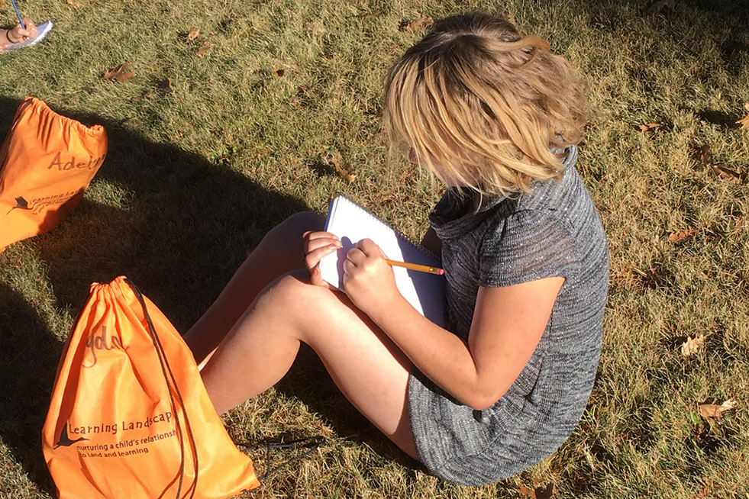
Case Study
- - - - - - - - - - - - - - - - - - - - - - - - - - - - - - - - - - - - - - - - - - - - -
Plumas County School District Outdoor Core
Words of Advice
Create a compelling model/pilot
Connect to community identity and values
Maintain existing programming, don’t retreat
Foundational pillars
  Education
  Restoration
  Recreation
Photo via Ten Strands
Elisabeth Johnson ​
Program Officer

Slide 7
Case Studies
- - - - - - - - - - - - - - - - - - - - - - - - - - - - - - - - - - - - - - - - - - - - -
Case Study review:
Mechanisms for connecting kids/schools to the outdoors:
  Outdoor classrooms and laboratories – on and off campus
  Curriculum
  Teacher support and training
Key elements to success:
  Built in capacity at district level
  Partnership
Weaknesses or barriers in case study:
  One program may not make sense statewide
Statewide Nevada possibilities:
  Technical assistance/grant program for individual districts to begin locally relevant “Outdoor Core” programs
Elisabeth Johnson ​
Program Officer

Slide 8
RECESS
- - - - - - - - - - - - - - - - - - - - - - - - - - - - - - - - - - - - - - - - - - - - -
Elisabeth Johnson ​
Program Officer

Slide 9
Vision Statement
- - - - - - - - - - - - - - - - - - - - - - - - - - - - - - - - - - - - - - - - - - - - -
To activate communities and leaders to grow PreK-12 outdoor learning spaces, actions, practices, and policies for the benefit of Nevada students’ overall wellness.
Elisabeth Johnson ​
Program Officer

Slide 10
RECESS
- - - - - - - - - - - - - - - - - - - - - - - - - - - - - - - - - - - - - - - - - - - - -
Elisabeth Johnson ​
Program Officer

