Slide 1

Nevada Recreation Economic Impact Study Results and Analysis
Frederick Steinmann
Director, University Center for Economic Development
The College of Business
University of Nevada, Reno
Nevada Division of Outdoor Recreation, Advisory Board on Outdoor Recreation
Tuesday, April 21, 2026

Slide 2
UCED’s Work in the Tourism, Hospitality, Arts, and Culture and Outdoor Recreation Space in Nevada
Current and Ongoing Efforts:
A Comprehensive Examination of Nevada’s Tourism and Hospitality Industry Sector’s Value Network and Supply Chain, May 2023, UCED Technical Report 2022/23-22
Statewide Summary Results of the 2025 Nevada Tourism, Hospitality, Arts, and Culture Resident Sentiment Survey, March 2025, UCED Technical Report 2024/25-12
An Evaluation of the Economic Impacts and Contribution of Outdoor Recreation in the State of Nevada, September 2025, UCED Technical report 2025/26-05
Comprehensive Economic Development Strategies (CEDS) for the Lincoln County Regional Development Authority (Lincoln County), the Northeastern Nevada Regional Development Authority (Elko, Eureka, Lander, White Pine Counties), and the Southwest Central Regional Economic Development Authority (Esmeralda and Nye Counties)
Nevada Outdoor Recreation Playbook Summit and Forum, October 21, 2025 on the Main Campus of the University of Nevada, Reno
Comprehensive Examination of the Supply Chain and Value Network of Nevada’s Creative Economy, UNR Spring 2026 BADM 779 Graduate Seminar in Logistics and Supply Chain Management (May 11, 2026)

Slide 3
Outdoor Recreation and Economic Impact in the Aftermath of the Pandemic
“Outdoor recreation development done equitably builds a sustainable economic strategy based on local and regional natural assets like forests, riverways, seashores, mountains, and more and connects those assets into value chains that grow local business ownership and high-quality jobs.”
2022 Contribution to US GDP by Related Sector
Apparel and Accessories: $67 billion
Sporting Events/Concerts/Amusement Parks: $37 billion
RV’ing: $36 billion
Game Areas (Golf, Tennis, etc.): $33 billion
Boating/Fishing: $32 billion
Government Expenditures: $23 billion
Guided Tours/Outfitted Travel: $18 billion
Other (Driving, Jogging, etc.): $15 billion
Motorcycling/ATVing/Recreational Flying: $15 billion
Productive Activities (Gardening, etc.): $14 billion
Hunting/Shooting/Trapping: $11 billion
Construction: $8 billion
Snow Activities: $7 billion
Equestrian: $6 billion
Climbing/Hiking/Tent Camping: $5 billion
Field Sports (Football, Lacrosse, Soccer, etc.): $5 billion
Bicycling: $3 billion
U.S. National Employment Impacts:
2020: 4.1 million jobs
2021: 4.6 million jobs
2022: 5.0 million jobs
2022 Contribution to U.S. GDP from Outdoor Recreation Travel Activities:
Non-Local Travel (>50 Miles): $180 billion
Local Travel (<50 Miles): $48 billion
Combined Total: $228 billion
“The Outdoor Recreation Economy by State”; Headwater Economics; November 27, 2023

Slide 4
Results from the 2025 Nevada Tourism, Hospitality, Arts, and Culture Resident Sentiment Survey

Slide 5
Question No. 9: Which of the following attributes of your community do you think the tourism, hospitality, arts, and cultural heritage industries have positively contributed to your community? Select all that apply.
Outdoor Recreation Activities, 800 respondents, 58.1%
Availability of and Access to Various Arts and Cultural Experiences, 593 respondents, 43.0%
Friendly/Welcoming Atmosphere and People, 580 respondents, 42.1%
Pace of Life, 491 respondents, 35.6%
Architectural Design/Visual Appeal of City/Town, 453 respondents, 32.9%
Variety of Restaurants and Dining Options, 431 respondents, 31.3%
Job Career/Opportunities, 360 respondents, 26.1%
Variety of Shopping, Stores, Retail Options, 332 respondents, 24.1%

Slide 6
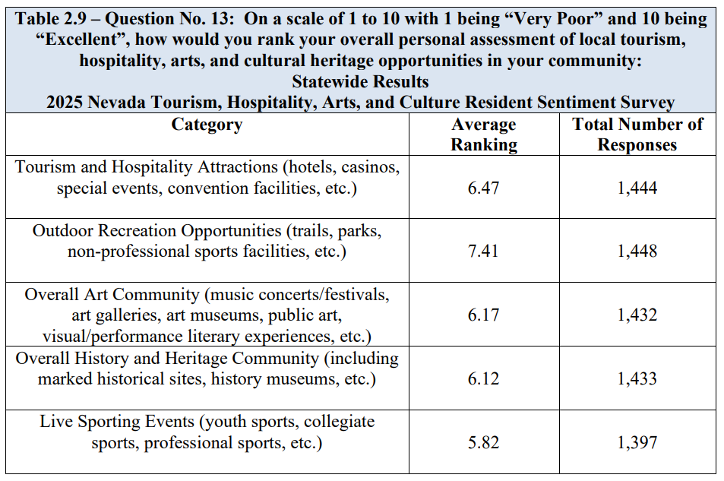

Slide 7
Question No. 19: Over the past year, please indicate whether or not you have used designated public lands in Nevada for engagement in the specific outdoor recreation activities listed and the approximate number of individual times you have engaged in each activity over the past year.
Walking, 1,196 respondents, 89.1%
Hiking , 1,030 respondents, 75.7%
General Fitness/Exercise, 1,020 respondents, 75.6%
Picnicking and Family Gatherings, 864 respondents, 65.1%
Wildlife Viewing/Birdwatching, 808 respondents, 60.6%
Astronomy/Stargazing, 773 respondents, 57.4%
Camping, 729 respondents, 54.7%
Outdoor Photography, Painting, Drawing, 864 respondents, 65.1%

Slide 8
Results of “An Evaluation of the Economic Impacts and Contribution of Outdoor Recreation in the State of Nevada”

Slide 10
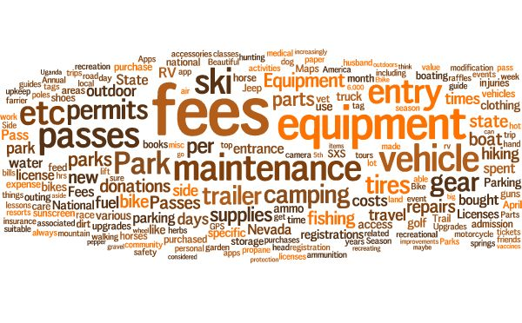

Slide 12
Statewide (Nevada) Trade Area Analysis Summary
Total Retail Sales (2022): $8.4 billion
Total Service Sales (2022): $53.2 billion
Total Retail + Service Sales (2022):
$61.5 billion

Slide 14
Trade Area Analysis Summary for Elko County
Total Retail Sales LEAKAGE (2022): -$199.38 million
Total Service Sales LEAKAGE (2022): -$37.27 million
Total Retail + Service Sales (2022):
-$236.65 million

Slide 15
Results of the Economic Impact Analysis
Estimated Economic, Employment, Income, and Tax Impacts of Outdoor Recreation:
Statewide (Nevada) Total Spending Impact: $4.770 billion
Statewide (Nevada) Total Employment Impacts: 46,034 individuals employed
Statewide (Nevada) Total Labor Income: $2.417 billion
Statewide (Nevada) Total Tax Impacts: $923.88 million
NOTE: Economic, Employment, Income, and Tax Impacts estimated by Radbridge Incorporated, www.radbridge.com

Slide 16
What Have We Learned and What Do We Continue Learn?
Key Takeaways:
Outdoor Recreation has and continues to have major economic impacts on the State of Nevada’s economy and the economic base of counties and individual communities throughout the state.
Outdoor Recreation continues to be a major driver of job creation and overall employment…in both the Tourism and Hospitality industry sector and for the broader economic base of the state.
Residents and Visitors who engage in outdoor recreation activities alike are significant contributors to these levels of economic impact.
Despite the significant and growing economic impact of outdoor recreation, significant ‘gaps’ exist in the overall outdoor recreation sector…both in-terms of consumer-to-business and business-to-business activity.

Slide 17
Frederick Steinmann
University of Nevada, Reno
fred@unr.edu
https://www.unr.edu/business/centers/uced

