Slide 1

Storey County Sheriff’s Off-Highway Operations Team

Slide 2

Off-highway Vehicle Program outline
About the program
Program Mission
Outreach & Education
Fleet & Equipment
Benefits

Slide 3

About The Program
The Storey County Sheriff’s Off-highway Operations Team (SOHO Team) was established in 2023 in response to an observed need for off-highway education and enforcement in Storey County, Nevada. Storey County is home to one of the largest per capita OHV ownerships in the State of Nevada. Each year, deputies respond to dozens of OHV related incidents, to include injuries, crashes, break downs, lost subjects, riders on private land, and more. Due to this, the SOHO Team was formed to help mitigate these issues. The program currently functions with five team members, who have experience with and have conducted training specific to off-highway vehicles and regulations.

Slide 4
Program mission: SOHO Team
Due to the historic and rugged nature of beautiful storey county, thousands of OHV enthusiasts visit and travel our trails annually.
The mission of the SOHO Team is to provide education and outreach to our OHV community. SOHO Team members RIDE trails to conduct NRS 490 enforcement, hold educational events, provide VIN inspections for registration, and provide assistance to riders IN NEED encountered on traiLS.

Slide 5
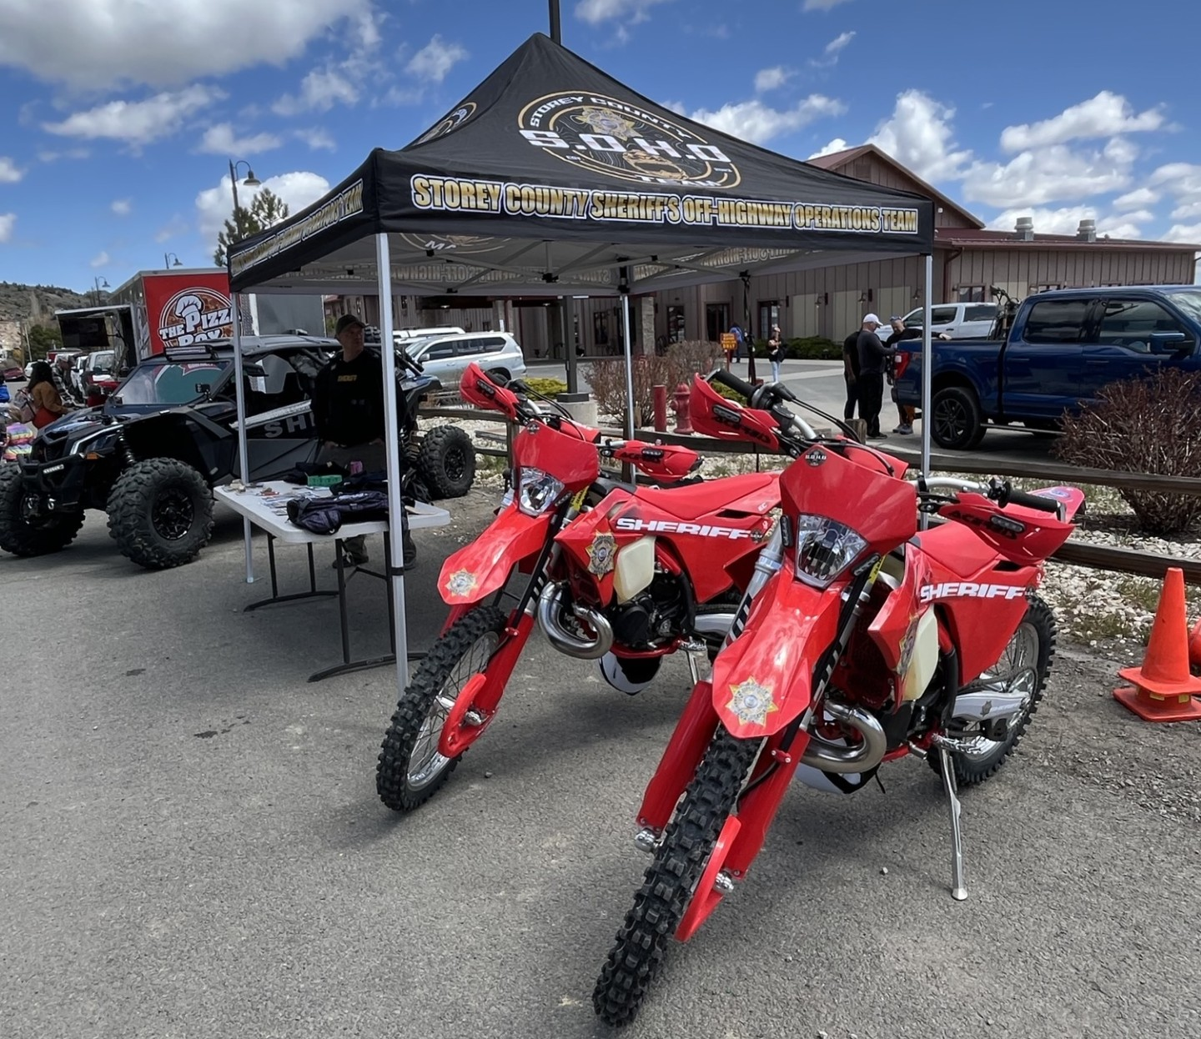
Outreach & Education
With a focus on outreach and education, the SOHO Team participates in a variety of events and programs.
Most notable for Storey County annually is the Virginia City Grand Prix motorcycle race. Since 1971, hundreds of motorcycle racers from around the country flock to Virginia City to participate in the unique race each year. During race weekend, the SOHO Team has a booth available to provide VIN inspections, education materials, and answer OHV related questions. Team members are able to educate riders on Nevada OHV regulations, provide insight into safety specific to riding conditions in Storey County, and connect with the community via shared interests.

Slide 6
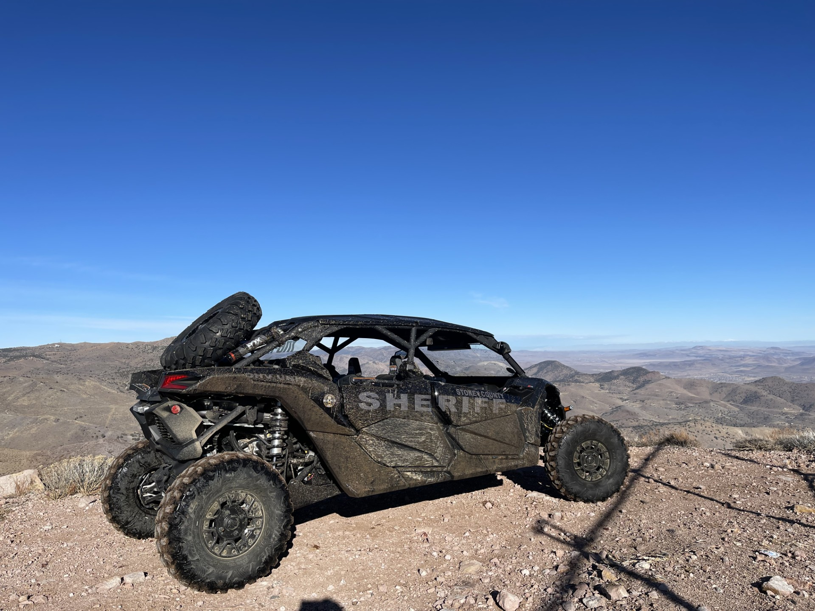
Education & Outreach
The SOHO Team also actively participates in other events around Storey County. During parades or events, the SOHO Team utilizes its fleet of off-highway vehicles to generate interest and awareness of the program.
Members of the community and tourists alike approach our team members with questions about our vehicles, regulations, or registration requirements. Community support of the program has been overall positive.
Future goals of the program include having booths set up at events, such as local racing or OHV specific events. The program is also working on conducting educational events such as VIN inspection events, safety and regulations seminars, and Learn To Ride events for children.

Slide 7
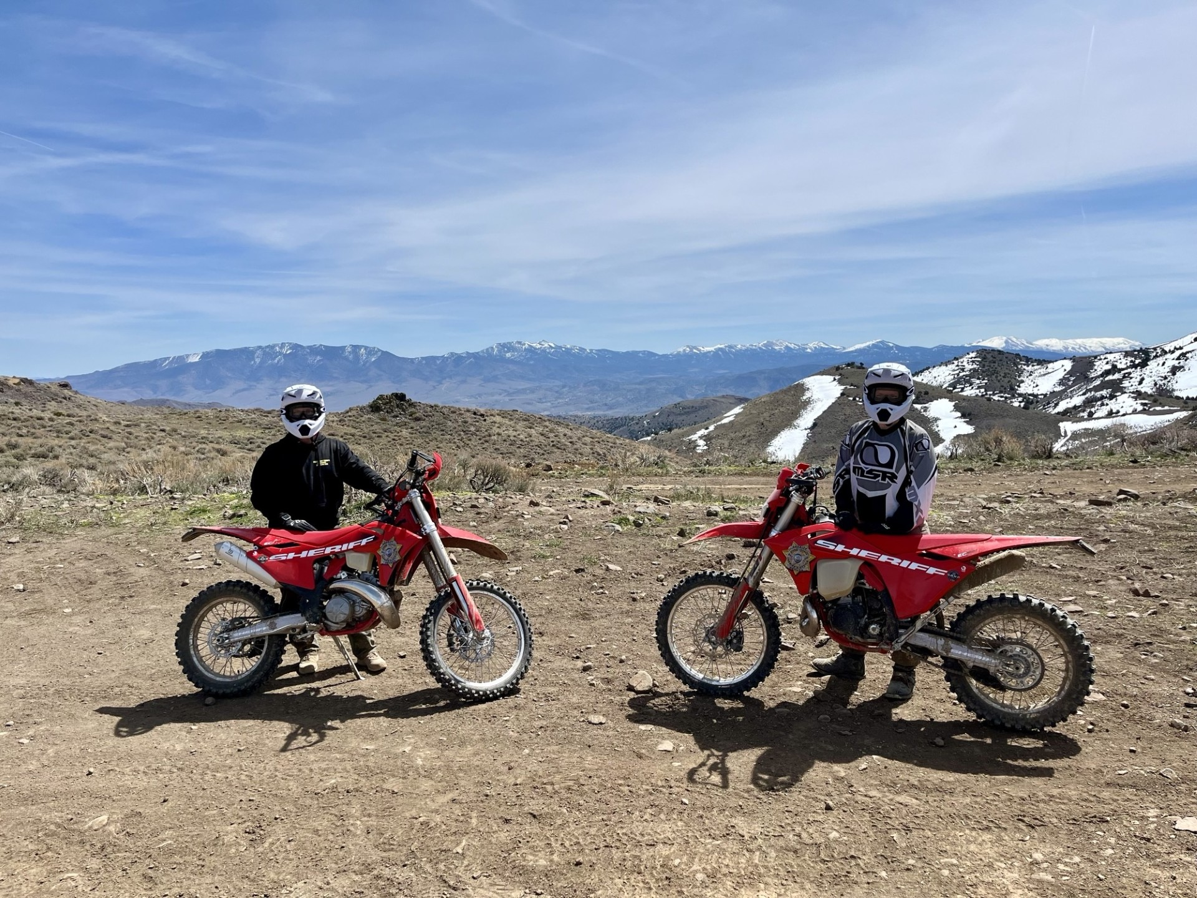
Fleet & equipment
Current SOHO Fleet:
2023 CanAm side by side
Two 2024 GasGas 300 dirt bikes
Equipment:
Team members are equipped with safety gear compliant with NRS 490 and DOT standards, to include but limited to, DOT approved helmets, goggles, gloves, boots, and riding apparel.

Slide 8
benefits
As mentioned previously in this presentation, the community support of the program since its creation in 2023 has overall been supportive. Interactions with the public or riders on trails has been positive.
Benefits of the SOHO Team are increased awareness and safety, better public knowledge of NRS 490 regulations, continued protection of our trails, and positive community engagement.
Education
Ensure the OHV community is educated on NRS 490 and promote proper safety
Enforcement
Enforce NRS 490 and provide solutions to issues, such as procedures to register by offering VIN inspections
Interaction
Foster collaborative growth and positive interaction between law enforcement and the community

Slide 9
thank you
Storey County SOHO Team
Sgt. Beaumont
bbeaumont@storeycounty.org

