Slide 1
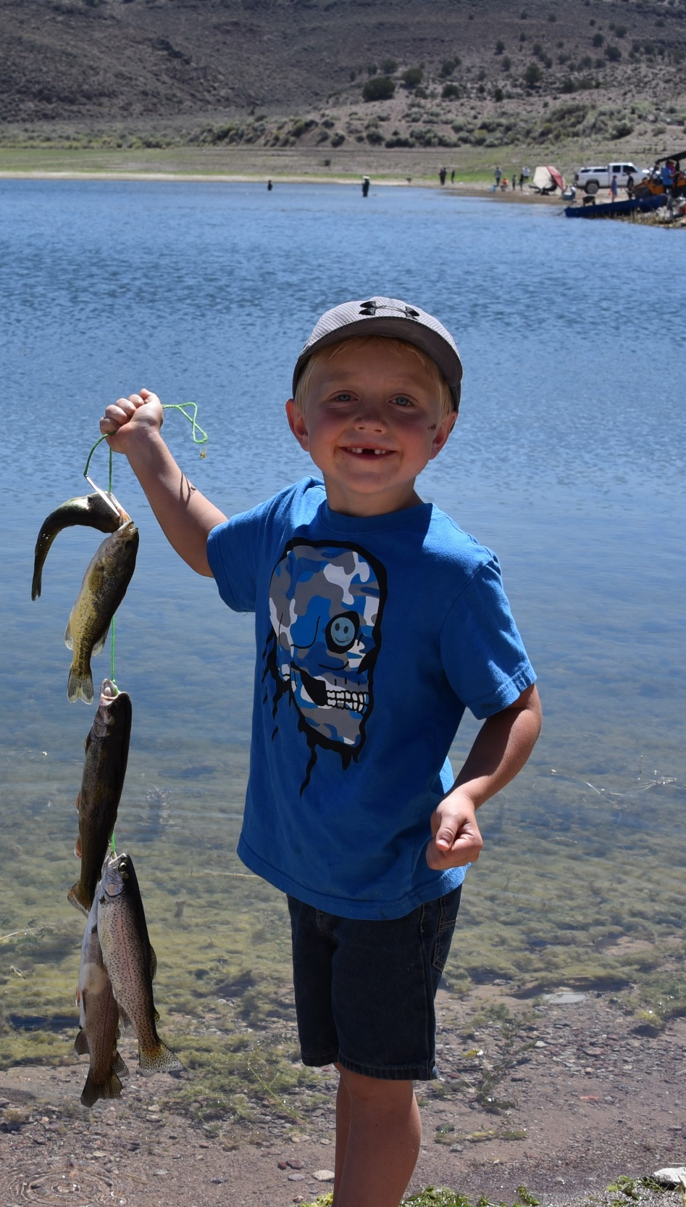



Nevada Outdoor Education & Recreation Grant Program
Technical Advisory Committee Prep
________
Presented by:
Kendal Scott
Outdoor Education Lead
Logo Owned by NDCNR.
ndor.nv.gov

Slide 2
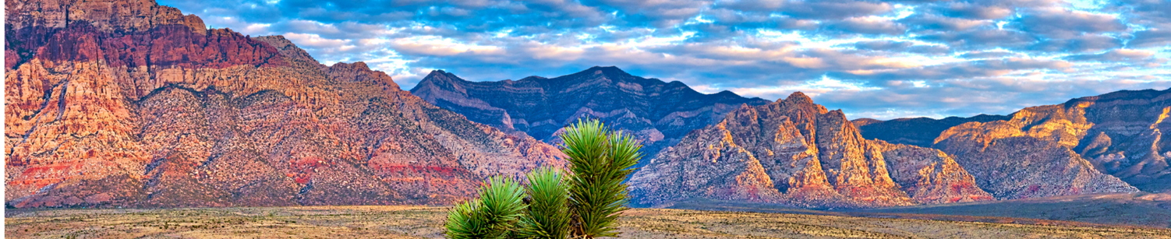


NOER Grant Overview
Photo taken and owned by NDCNR, permission granted to NDOR
- - - - - - - - - - - - - - - - - - - - - - - - - - - - - - - - - - - - - - - - - - - - - - -
Purpose: To provide high-quality outdoor education and recreation opportunities for Nevada students facing barriers to outdoor access.
Goals:
  Provide Nevada students with high-quality opportunities to directly experience the natural world
  Expose young minds to the environment, agriculture, and natural resources to promote environmental literacy
  Seek to improve academic performance, self-esteem, personal responsibility, community involvement, personal health, or understanding of nature for all our Nevada youth (through age 18)
Notes:
History: Created in 2019 by the legislature, originally under state parks
Moved to NDOR with creation of NDOR

Slide 3
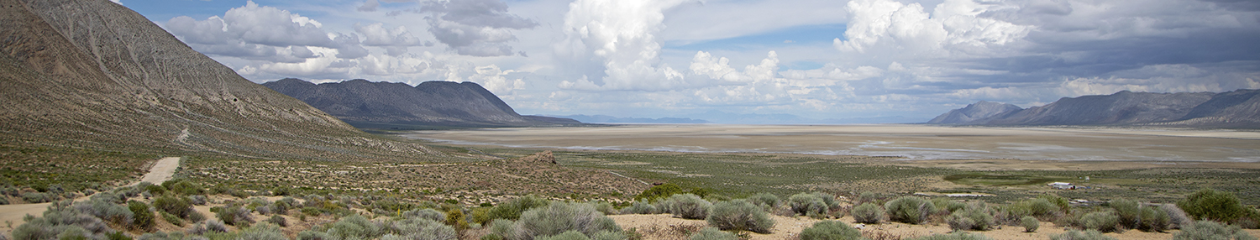
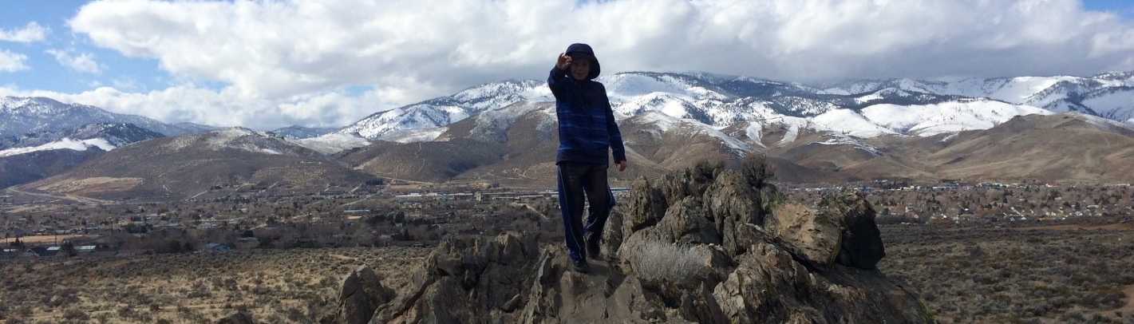
NOER Grant
Photo taken and owned by NDCNR, permission granted to NDOR
- - - - - - - - - - - - - - - - - - - - - - - - - - - - - - - - - - - - - - - - - - - - - - -
Priorities
  Primarily focused on serving students who face barriers to outdoor access, as measured by review of written application and eligibility for free or reduced-price meals pursuant to 42U.S.C. 1751 et seq.
Notes:
Looking for projects that include time outdoors for kids
Audience is a large part of scoring- focus projects on areas of most need- students facing financial barriers or otherwise. Two part, stats and narrative

Slide 4
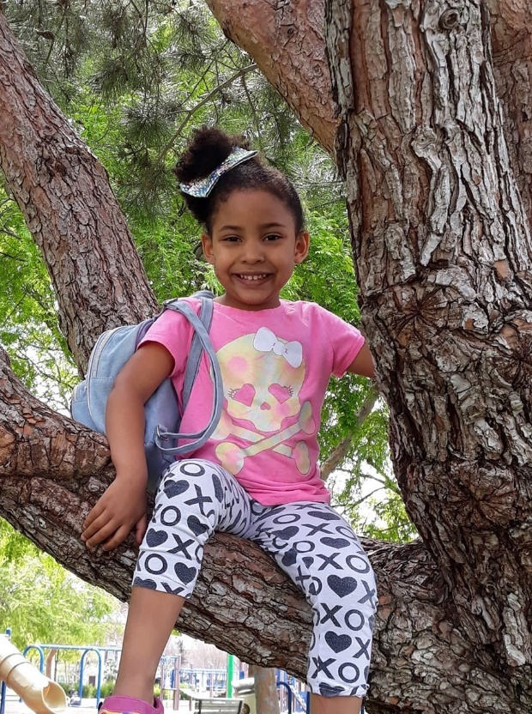
Funding
- - - - - - - - - - - - - - - - - - - - - - - - - - - - - - - - - - - - - - - - - - - - -
$250,000 available
Total ask:
$1,382,327
Total Tier II ask:
$1,254,105
  34 eligible proposals (53.1%)
$200,000 to distribute
Total Tier I ask:
$128,222
  29 proposals (46.9%)
$50,000 to distribute
Elisabeth Johnson ​
Program Officer
Notes:
If the TAC does not spend exact $ reserved for Tier II, we will allocate more towards Tier I, or there is the option for partial funding of projects as well.
Keep in mind sometimes with programming it is all or nothing for funding, not like infrastructure where you can pay for things in stages- think and ask presenters about what they could do programming without within their budgets.
1 ineligible Tier II project, still going through Tier I for eligibility, but so far, they are all eligible.
Feedback period update: 23 applications, $672,898, most Tier II grants.

Slide 5
Distribution of Proposals
- - - - - - - - - - - - - - - - - - - - - - - - - - - - - - - - - - - - - - - - - - - - -
Tier II Proposals Breakdown
15 Counties:
  Washoe: 17
  Lyon: 9
  Clark: 8
  Carson City: 8
  Douglas: 7
  Storey: 7
  Churchill: 5
  White Pine: 4
  Mineral: 4
  Humboldt: 4
  Pershing: 3
  Lander: 3
  Elko: 3
  Eureka: 3
  Nye: 1
Sovereign Nations/Reservations/Tribal Orgs: 5
Statewide: 3
Tier I Proposals Breakdown
11 Counties:
  Clark: 12
  Washoe: 12
  Douglas: 4
  Mineral: 2
  Elko: 2
  Churchill: 2
  Lyon: 2
  Carson City: 1
  White Pine: 1
  Nye: 1
  Pershing: 1
Sovereign Nations/Reservations/Tribal Orgs: 1
Statewide: 1
Elisabeth Johnson ​
Program Officer
Notes:
Not going to add up to 34, many applications serve multiple counties, so these are the numbers of proposals that include these counties
3 different nations/reservations named, but more who indicated they would be working within counties
None specifically for Lincoln, Esmeralda – could ask statewide projects to focus efforts there

Slide 6
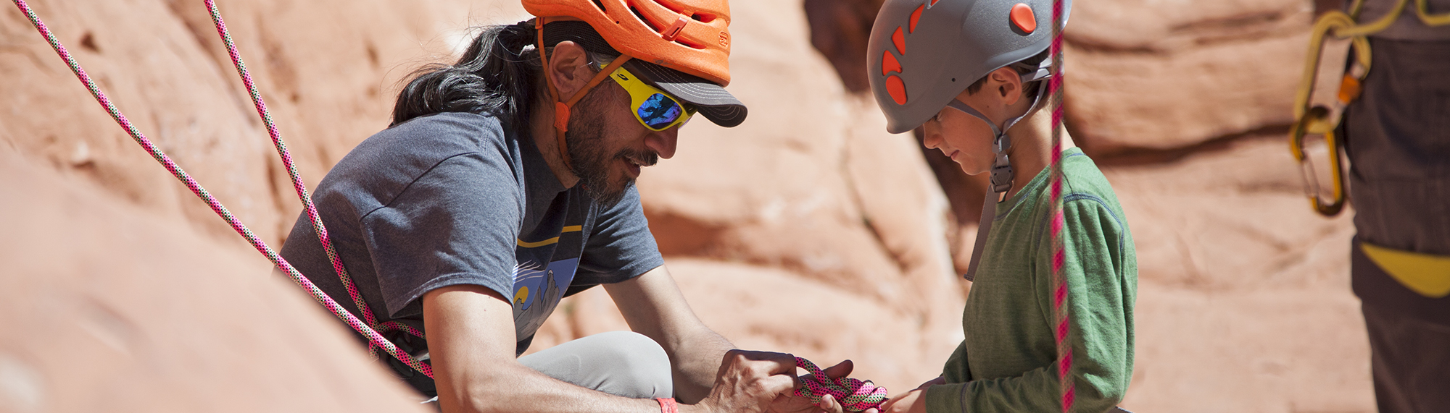
Photo courtesy of Travel Nevada
Timeline
- - - - - - - - - - - - - - - - - - - - - - - - - - - - - - - - - - - - - - - - - - - - -
October : TAC receives all application materials
October 12: ABOR Meeting - NOER TAC Training
November 1: Return scores for written applications
November 7 & 8: Technical Advisory Committee Meets for Presentations
  Schedule to come
November 30: NDOR makes final decisions for Tier I and Tier II grants
December: Award notifications and agreements
6
Entire slide created by NDCNR, Photo owned by NDCNR
Notes:
Plan on the whole day, we are working now to schedule those presentations – 20 minutes per applicant- you can adjust scores from written material at that time

Slide 7
Eligible Programs and Costs
- - - - - - - - - - - - - - - - - - - - - - - - - - - - - - - - - - - - - - - - - - - - -
Programs include, but are not limited to, the following:
Backpacking
Camping
Canoeing and kayaking
Environmental outdoor education
Ranching
Fishing
Hiking
Hunting
Gardening
Orienteering
Outdoor based after school programs and camps
Outdoor cooking
Rock climbing
Electronic devices (and associated software) such as Global Positioning Systems (GPS), avalanche beacons, tablets, etc., if used as part of the program
Camping equipment and supplies
Fees for park entry and camping
Fishing equipment and supplies
Food and non-alcoholic beverages
Hunting and archery equipment and supplies
In-state transportation and travel, including to bordering counties and cities in other states
Leasing transportation, mileage, and gasoline
Lodging and facility rentals for programs and events
Non-motorized boats
Staff time if directly related to project
Photo courtesy of Travel Nevada
Elisabeth Johnson ​
Program Officer

Slide 8
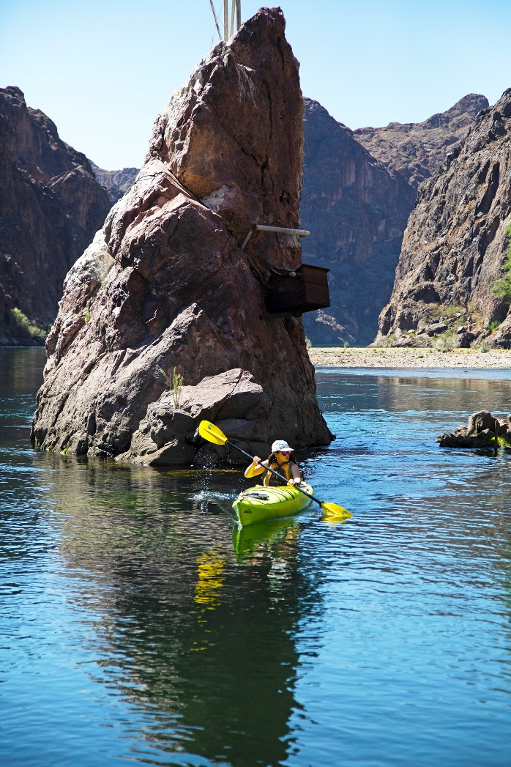
Ineligible programs
- - - - - - - - - - - - - - - - - - - - - - - - - - - - - - - - - - - - - - - - - - - - -
Ineligible programs include, but are not limited to, the following:
Facility construction projects
Organized Team Sports (i.e. baseball, soccer, or basketball)
Promotional or fundraising events
Projects that do not have an outdoor component
Out-of-State Travel, except for bordering counties and cities
Out-of-State Students
Purchase of automobiles, vehicles, or boats with motors
Pre-agreement Costs, unless pre-approved by Administrator
Religious activities
Elisabeth Johnson ​
Program Officer
Notes:
Pause for questions so far
Some gray areas – garden beds are eligible, digging a hole to post a bat box.

Slide 9
Matching Funds
- - - - - - - - - - - - - - - - - - - - - - - - - - - - - - - - - - - - - - - - - - - - -
Eligible Match
A grantee’s matching share may include one or a combination of the following:
Appropriations and cash
Donations–the value of using cash, equipment use, staff time, volunteer time, materials, or services
Grants–federal, state, local, or private
Not allowed as Match
Costs that are double counted (that is, any cost included in more than one project)
Anything considered an ineligible cost or activity.
Costs that are not necessary or an integral part of the project scope.
Elisabeth Johnson ​
Program Officer
Notes:
Match is not required!
This is an objective score- but you may want to review it anyway.

Slide 10
Program Impact
- - - - - - - - - - - - - - - - - - - - - - - - - - - - - - - - - - - - - - - - - - - - -
Connect Students with Nature
Academic Success
Environmental Literacy
Foster Stewardship
Physical Health
Self Confidence
Personal Responsibility
Cultural Education
Community Involvement
Self Confidence: Programs may teach to markers of social-emotional learning or provide opportunities for leadership, self-reflection, growth, independence, or setting and pursuing personal goals.
Connect Students with Nature: Nature connectedness happens when individuals feel they belong in and are a part of nature. To build this connection, programs may provide significant time in or sensory interaction with the outdoors, focus on forming social connections or facilitating positive experiences and moods in nature, or provide learning about Nevada’s nature.
Elisabeth Johnson ​
Program Officer
Notes:
Not exhaustive definitions, you can explain why your program addresses these impacts beyond definitions
Impacts are lumped together in the application questions – make sure to answer to all that you can – show application
Did they provide examples of how their programming will adhere to these definitions, or do they provide their own definition with sound logic?
If things are jargony, or there are acronyms you don’t understand, give Kendal a call/email
Look at application

Slide 11
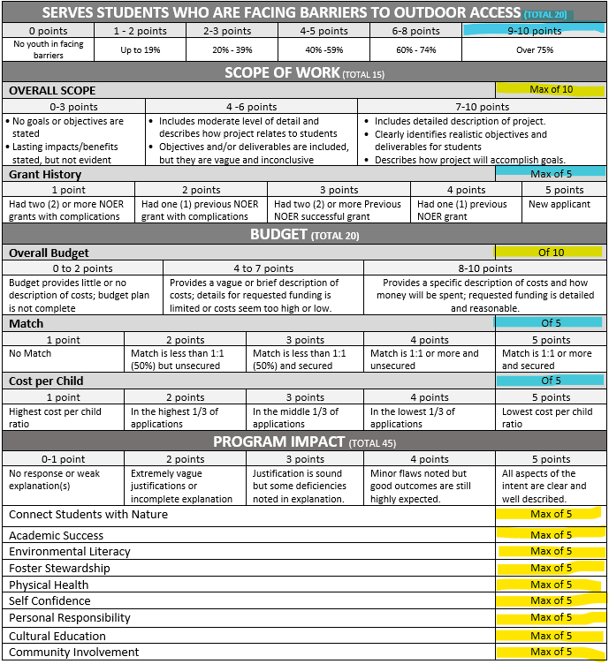
Scoring
- - - - - - - - - - - - - - - - - - - - - - - - - - - - - - - - - - - - - - - - - - - - -
Elisabeth Johnson ​
Program Officer
Notes:
Blue is objective scores that I will have calculated ahead of time
Yellow is what TAC will be scoring
You will submit written application scores by the end of the day Nov 1
We will have your scores ready for you- you can adjust them based on presentations.
TAC submits ranked list of recommended awards. NDOR Administrator makes final decisions.
Look at excel scoresheet.

Slide 12
November 7TH & 8TH TAC Meeting
- - - - - - - - - - - - - - - - - - - - - - - - - - - - - - - - - - - - - - - - - - - - -
Location: Carson City (DCNR) or virtual
20-minute presentations per applicant
10 minutes on the project
10 minutes for questions
Submit recommendations for funding to NDOR Administrator
Elisabeth Johnson ​
Program Officer
Notes:
Scheduling presentations now next week- will be on agenda to come for Nov 7
# of presentations and planned time

Slide 13
Conflict of Interest
- - - - - - - - - - - - - - - - - - - - - - - - - - - - - - - - - - - - - - - - - - - - -
Potential Conflicts of Interest
I have a family member who stands to benefit from the project.
I have a friend who stands to benefit from the project.
I have a business stake in the results of the verification effort.
I have no conflict of interest to report.
Elisabeth Johnson ​
Program Officer
Notes:
Interested in economic benefit- but also mention personal ties, just to have on record. will be emailed

